Slide 1
Quantum Lecture 4C
Last preparation lecture before the final
CHSH exercise at DTU

Slide 2
Agenda
Recap
Questions
A more precise in depth walk-over
An Exercise with previous data
Qiskit programming exercise

Slide 3
8:15 – 8:30 Recap
EXAM’s in detail
Mandatory report
MathLab
CodeRanch
Mulitiple choice

Slide 4
8:30 – 8:45 Questions
Questions
Questions
Questions
Questions
Questions

Slide 5
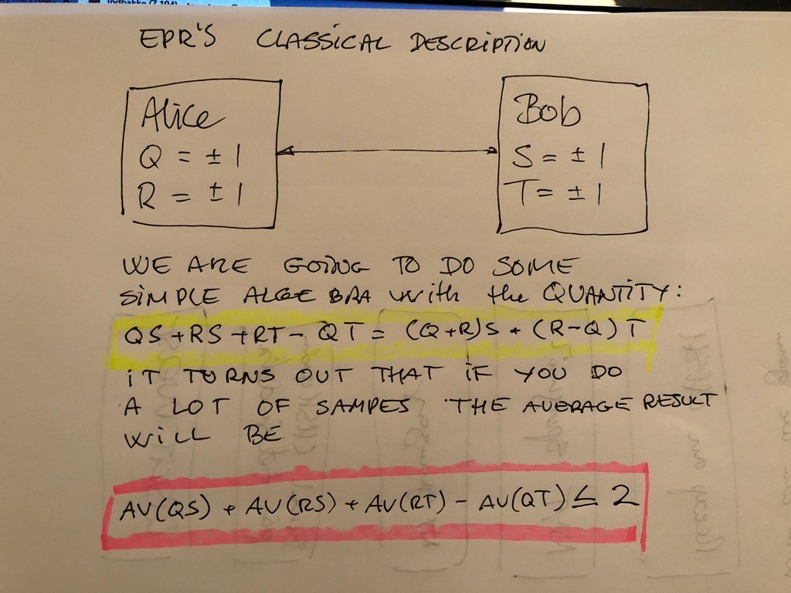
9:00 – 9:45 New Walk-over

Slide 6
9:00 – 9:45 New Walk-over
Q | R | S | T | (Q+R)S + (R-Q)T
1 | 1 | 1 | 1 | 2
1 | 1 | 1 | -1 | 2
1 | 1 | -1 | 1 | -2
1 | 1 | -1 | -1 | -2
1 | -1 | 1 | 1 | -2
1 | -1 | 1 | -1 | 2
1 | -1 | -1 | 1 | -2
1 | -1 | -1 | -1 | 2
-1 | 1 | 1 | 1 | 2
-1 | 1 | 1 | -1 | -2
-1 | 1 | -1 | 1 | 2
-1 | 1 | -1 | -1 | -2
-1 | -1 | 1 | 1 | -2
-1 | -1 | 1 | -1 | -2
-1 | -1 | -1 | 1 | 2
-1 | -1 | -1 | -1 | 2
Notes:
This is a little bit bit more comprehensive than last time 16 events in total

Slide 7
10:00-10:45
Prepare for the DTU exercise by this Template

Slide 8
11:00-11:30 CHSH Qiskit Exercise
https://github.com/qiskit-community/qiskit-community-tutorials/blob/master/awards/teach_me_qiskit_2018/chsh_game/CHSH%20game-tutorial.ipynb

Slide 9
11:30 A summation and next time
Recap and Exam
Questions
A more precise in depth walk-over
An Exercise with previous data
Qiskit programming exercise
We start with a Zoom presenation on line so You could stay at home for this
Meet at DTU at 13:00 at address below 29th of October
Technical University of Denmark
DTU Physics
Fysikvej bld. 307, room 258
DK-2800 Kgs. Lyngby

